Slide 1
Breast Cancer Detection through Screening Mammogram
Nhung Hong Le (nhl256)
B V Nithish Addepalli (bva212)
Ravi Choudhary (rc3620)

Slide 2
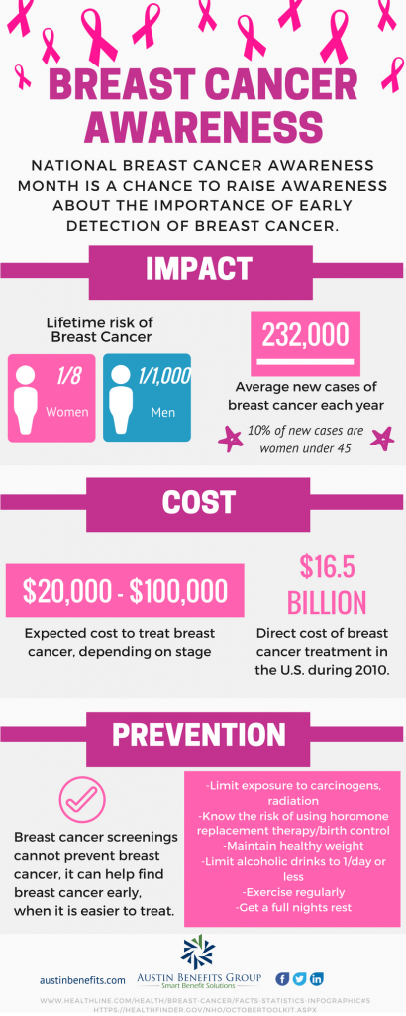
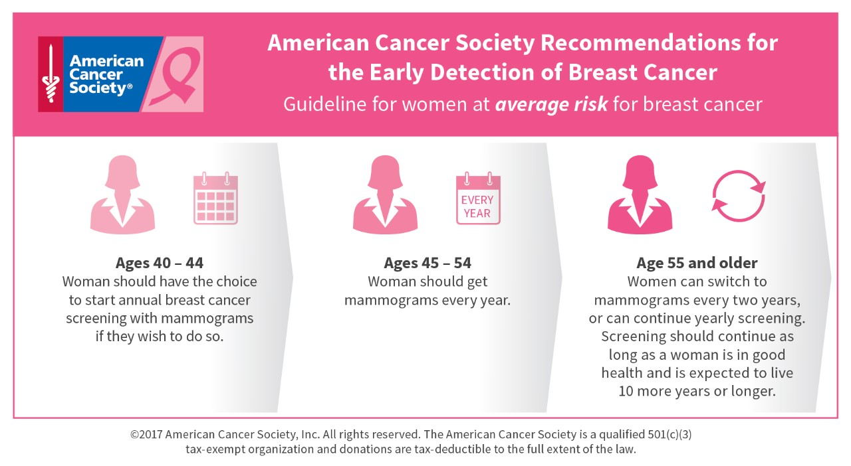
Motivation

Slide 3
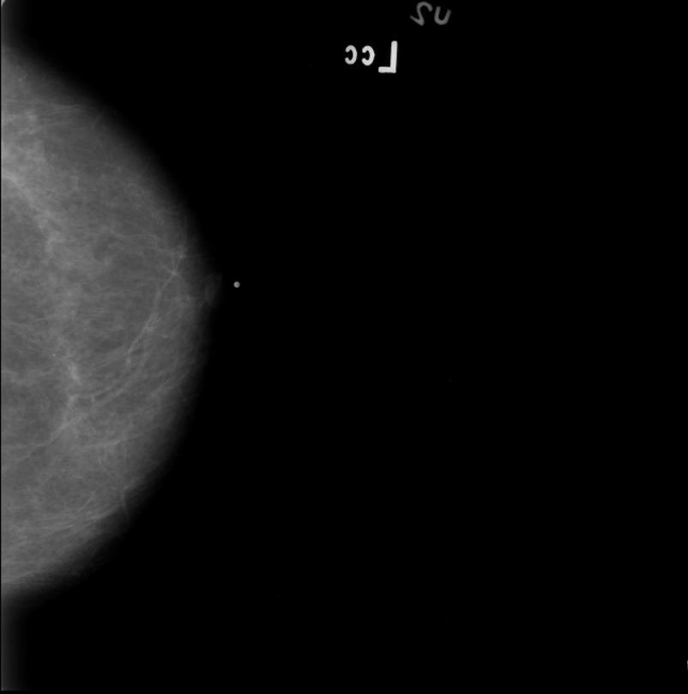

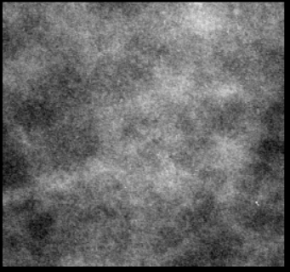
Dataset
CBIS-DDSM – DICOM images with metadata in CSV files
Data augmentation by flipping images
Metric | Total | Train | Test
# Patients | 1,645 | 1,293 | 352
# Scans | 3,563 | 2,859 | 704
+
Mammogram
ROI Mask
Region of Interest

Slide 4
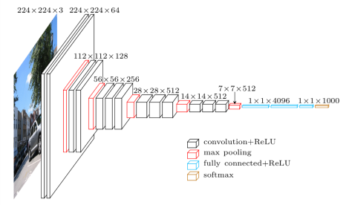
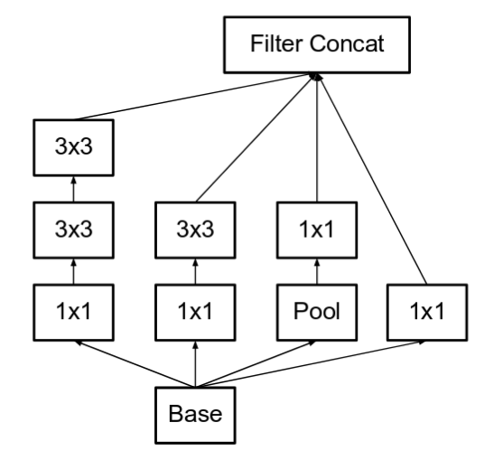
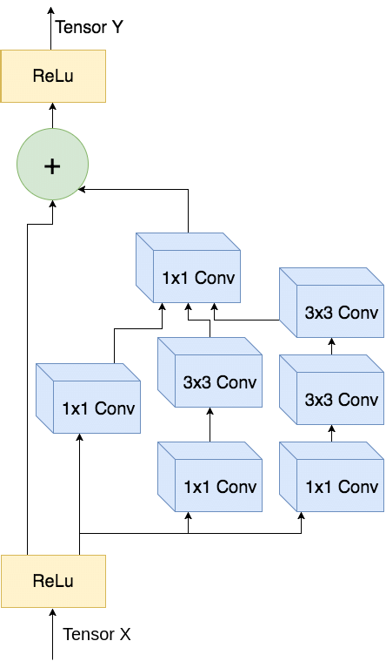
Proposed Methods
VGG Net
Inception Net 3
Inception Res-Net
Experiments:
Using Spatial Pyramid Pooling layer (SPP- Net) to facilitate model in taking images of different sizes
Training separate CNN Modules for MLO and CC
Use of ROI images to improve model performance

Slide 5


Loss and Evaluation Metrics
Loss Functions:
Binary Cross Entropy:
Hinge Loss:
Evaluation metrics:
AUC
Accuracy
F1 Score

Slide 6

Timeline
02/26
Proposal
Presentation
03/15
Clean Data
04/25
Model Development/ Experiments
05/09
Final Presentation

